Slide 1
Lines of Credit to East Africa :
Enabling Development Transformation
March 10, 2014
New Delhi

Slide 2
Our Presence in Africa
Presence in over 50 countries
Credit aggregating over USD 6.44 billion currently extended by Exim Bank for projects in Africa.

Slide 3
Our Presence in Africa
Variety of products already tested in Africa
Lines of Credit
Buyer’s Credit
Buyer’s Credit under NEIA
Overseas Investment Finance
Working Capital facilities
Non-fund based facilities

Slide 4
Lines of Credit Programme
Lines of Credit (LOCs)
Exim’s own LOCs to developing countries and regional development banks
At behest of GOI, concessional LOCs to developing countries in Asia/ Africa/ Latin America with a long-term perspective. While Exim raises the resources and funds disbursement, GOI provides guarantee and interest equalisation support under IDEAS Scheme
Status of LOCs
No. of LOCs operative : 187
No. of countries covered : 75
Total amount of LOCs sanctioned : US$ 10.21 bn
Notes:
4

Slide 5
Regional Distribution of GOI-supported LOCs – 28.02.2014
OVERALL: USD 10 Billion
AFRICA= USD 6.2 Billion
AFRICAN COUNTRIES ARE MAJOR BENEFICIARIES OF LINES OF CREDIT
Notes:
5
5

Slide 6
Lines of Credit Extended to Africa
Promoting Economic Development in the Region
133 LOCs currently in operation in Africa amounting to USD 6.28 billion;
48 Countries covered include:
Angola
Burkina Faso
Burundi
Benin
Botswana
Cameroon
Cape Verde
Chad
Cen. Afr. Rep
Comoros
D R Congo
Cote d’Ivoire
Djibouti
Somalia
Egypt
Eritrea
Ethiopia
Gambia
Gabon
Guinea Bissau
Guinea
Ghana
Kenya
Liberia
Lesotho
Madagascar
Malawi
Mali
Mauritius
Mauritania
Morocco
Mozambique
Namibia
Niger
Nigeria
Rwanda
Sierra Leone
Senegal
Seychelles
Sudan
Swaziland
Tanzania
Togo
Tunisia
Uganda
Zambia
Zimbabwe
R. Congo
Institutions include:
Afrexim Bank
ECOWAS Bank for Investment & Development
PTA Bank
West African Development Bank
Seychelles Marketing Board
Indo-Zambia Bank

Slide 7
Lines of Credit to East Africa
55 Lines of Credit to East Africa covering 16 countries with credit commitments aggregating USD 2.91 billion including Exim Bank’s own LOCs
Notes:
7 LOCs Egypt and uganda +105 mn Exim LOC

Slide 8
Projects in Burundi
Under GOI-supported LOC of USD 80 million, a power generation project for Kabu Hydro Electric Project is at advanced stage of implementation.
Two more LOCs for farm mechanisation and preparation of DPR for integrated food processing complex have been extended. Contracts awaited.

Slide 9
Djibouti - Ali Sabieh Cement Project
The Ali Sabieh cement project in Djibouti has been funded by way of LOCs aggregating USD 49.13 million to the Government of Djibouti.

Slide 10
Ethiopia – Sugar factories
LOCs aggregating USD 640 million have been extended to the Government of Ethiopia for financing the sugar industry rehabilitation in Ethiopia.
Wonji-Shoa, Finchaa and Tendaho sugar factories.

Slide 11
Ethiopia – Sugar factories (contd)
Upon completion, it would transform the entire Ethiopian economy from being a sugar deficient to being a sugar surplus economy

Slide 12
Other Projects in Ethiopia
Transmission & Distribution Line project under LOC of USD 65 million, already completed.
Ethio-Djibouti Railway Line : The ambitious Ethio-Djibouti railway line would connect Assaita in Ethiopia to Tadjourah Port in Djibouti covering 216 kms.

Slide 13
KENYA - KIBOS CANE SUGAR PROCESSING PLANT
Sugar cane crushing and processing plant designed, supplied and commissioned at Kibos Sugar Industries in Kenya

Slide 14
Power Transmission Projects in Kenya
Under GOI-supported LOC of USD 61.60 million, 4 Power Transmission Projects are being executed for KETRACO. Contract execution has begun recently.

Slide 15
Projects in Lesotho
Under a GOI-supported LOC of USD 5 mn tractors have been supplied and irrigation projects have been executed.
Under 2nd LOC of USD 4.70 mn a Project for Vocational Training Center for empowerment of youth and women is under execution

Slide 16
Malawi - Agro-processing plant
Equipments supplied, installed, commissioned and training provided by Indian company, under the LOC of USD 30 mn to Govt. of Malawi, for One Village One Product Programme (OVOP) and Small Holder’s Irrigation Programme

Slide 17
Malawi-Tractors
Supply of 177 tractors to Malawi under the LOC of USD 50 million have been distributed to Agricultural Development Divisions in Malawi where rural farmers are now able to hire them for use in their fields.

Slide 18
Projects in Mozambique
Under various GOI-supported LOCs aggregating USD 639.44 mn to Mozambique, various power transmission projects, rural electrification, irrigation, construction of borewells, IT Park projects have been/are being executed.

Slide 19
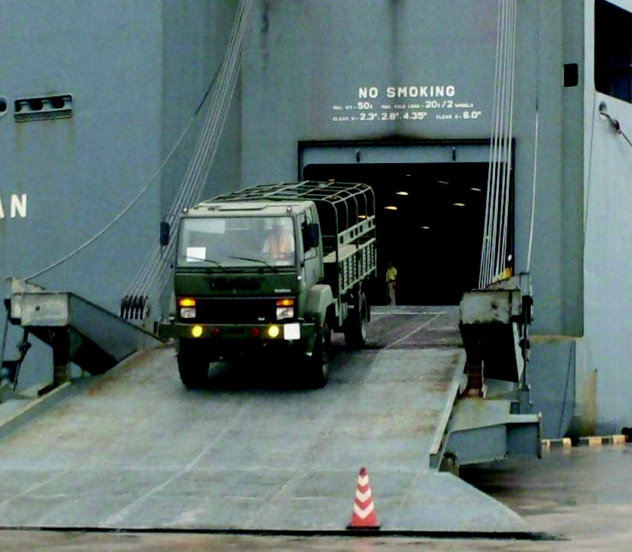
Tanzania – Supply of Trucks, other vehicles and spare parts
Contract with the Ministry of Defence and National Service, Government of Tanzania for supply of 723 Trucks, other vehicles and spare parts under the LOC of USD 36.56 million.

Slide 20
Tanzania- Supply of tractors, pumps and equipments
Supply of tractors, pumps and equipments under the LOC of USD 40 million to Government of Tanzania.

Slide 21
GOI-supported LOCs to Zambia
Itezhi-Tezhi Hydro Electric Project under USD 50 million, under implementation
Execution is about to commence for pre-fabricated health posts in Zambia under another LOC of USD 50 million.

Slide 22
Zambia – Supply of Vehicles
Vehicles procured by Govt. of Zambia for various departments, which include – Zambia Police, Zambia National Services, and the Zambia Defence Forces.
Supply of vehicles had majorly improved the Police presence and patrolling all over the country, even in far flung remote areas.

Slide 23
ZAMBIA - ZAMBEZI PORTLAND CEMENT PLANT
A 1000 TPD cement plant designed, supplied and being commissioned at Zambezi Cement Plant in Zambia

Slide 24
Impact of the GOI-LOCs
A variety of developmental projects in sectors like Agriculture, Transportation, Manufacturing (cement, sugar), Energy (generation, transmission and rural electrification) and Infrastructure have been covered.
They have strengthened bilateral cooperation.
Helped people at Grass Root level.

Slide 25
Impact of the GOI-LOCs
In a nutshell :
“ AAA + C through B = T ”

Slide 26
Some of the Projects supported by Exim Bank

Slide 27
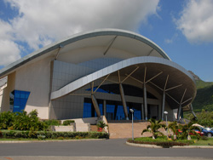
MAURITIUS - CONVENTION CENTRE
Exhibition Centre for Les Pailles Conference Centre (Swami Vivekananda International Convention Center) in Mauritius

Slide 28
MAURITIUS - EBENE CYBER TOWER
Ebene Cyber Tower, an intelligent building to house IT companies in Mauritius, designed and built on turnkey basis
Notes:
Sugar plant and equipment supplied to Zambia by ISGEC, New Delhi

Slide 29
TANZANIA - SONGO SONGO GAS ELECTRICITY PROJECT
Exim Bank has supported the Songo Songo Gas Electricity Project in Tanzania, supplied and commissioned

Slide 30
Exim Bank’s Programme for Buyer’s Credit under NEIA

Slide 31
Buyer’s Credit under NEIA
Exim Bank has introduced this product in conjunction with ECGC under GOI’s National Export Insurance Account (NEIA), to finance and facilitate India’s project exports needing deferred credit on medium or long term basis.
Borrowers under the Programme are governments of recipient countries or parastatal project authorities backed by sovereign guarantee.
The eligibility for coverage under Buyer's credit, inter-alia, focuses on (i) country risk perception, (ii) track record and sound financials of Indian project exporter and (iii) conformity with the RBI’s Memorandum of Instructions on Project and Service Exports.
Presently, a positive list of 47 countries has been identified by ECGC for which Indian exporters can avail Buyer’s Credit under NEIA.

Slide 32
Buyer’s Credit under NEIA
Indian project exporters of repute with good track record are supported under the Program.
The Bank extends the credit directly to overseas buyer of projects from India without recourse to the Indian exporter.
The interest rate payable by overseas borrowers will have a tenor-linked pricing:
LIBOR + 2.25% p.a. for tenor upto 8 years.
LIBOR + 2.50% p.a. for tenor of 9 to 12 years
LIBOR + 3.00% p.a. for tenor of 13 to 15 years
Facility to cover 85% of contract value. Goods and services for minimum 75% of the value of goods and services covered under the Scheme must be of sourced from India.
Credit Period usually between 8 to 12 years. Longer tenors considered on merits of the proposal.

Slide 33
Buyer’s Credit under NEIA
Exim Bank obtains credit guarantee cover under NEIA through ECGC and the NEIA guarantee fee is borne either by the project exporter and/or the overseas borrower, as may be agreed.
The NEIA Guarantee Fee is a flat rate of 6% of the value of the total principal credit for 150% loss coverage (including exchange fluctuation) irrespective of the tenor of the credit, and the guarantee fee on the interest portion for 150% cover (incl. exchange fluctuation) is a flat 1% p.a. (or 6% if paid upfront) on the amount of interest payable.
Indian exporters can obtain payment of eligible value from Exim Bank, without recourse to them, against negotiation of shipping documents.

Slide 34
ECGC’s Positive List of Countries under NEIA
Country | ECGC Rating
Afghanistan Algeria Bangladesh Barbados Belarus Bhutan Botswana Cameroon Djibouti Egypt Ethiopia Gabon Ghana Guinea Indonesia Iran* Kazakhstan Kenya Kuwait Latvia Liberia Libya Malawi Maldives | C2 A2 B1 B2 C1 B2 A1 B2 B2 B1 C1 B2 B2 C2 B1 B1 B1 B1 A2 B2 C1 B1 C1 C1
Country | ECGC Rating
Mauritius Moldova Mongolia Morocco Mozambique Myanmar Namibia Nepal Nigeria Republic of Congo Romania Russia Rwanda Senegal Sri Lanka Syria Tanzania Togo Uganda Uzbekistan Vietnam Zambia Zimbabwe | A2 C2 C1 A2 C1 B2 B1 B1 B1 B2 B2 A2 C1 B2 A2 C1 B2 C2 B2 B1 B1 B2 D
*Credit will be denominated in Indian Rupees. Interest rates to be advised on a case to case basis.

Slide 35
Buyer’s Credit under NEIA – Projects in East Africa
Under this Programme, Exim Bank has supported two projects in East Africa.
First project supported under the Programme is a 132 kV transmission line project in Zambia valued at USD 63.39 mn, which is at advanced stage of implementation.
Second project recently covered is a contract for construction of an integrated LPG and bitumen storage facility with marine loading terminal and distribution and bottling infrastructure including bulk/truck loading/unloading infrastructure, at Beira port, Mozambique valued at USD 34.79 mn.

Slide 36
In sum
Any project which needs funding can be supported in the following manner :
Buyer’s Credit under NEIA
Short term Buyer’s Credit
Supplier’s Credit to the Indian exporter
Commercial Lines of Credit to acceptable banks in the country where the project is being set up or to regional development banks like PTA Bank, etc.

Slide 37
In sum
In case the project is funded by the project authority, Exim Bank can extend support by way of :
Guarantees
Letters of Credit
Temporary Cashflow deficit financing
In case an Indian company wants to set up a Joint Venture / Wholly Owned Subsidiary :
Term Loan
Stand-By Letters of Credit
Working capital facility to the overseas venture
Equity participation

Slide 38
FINANCING, FACILITATING INDIA’S TWO WAY TRADE & INVESTMENT
EXIM BANK
At All Stages of Export Business Cycle
Export Marketing
Pre- Shipment
Export Production
Post- Shipment
Export Product Development
Investment Abroad
Import Finance
Advisory Services
Notes:
Developing countries lacking forex can buy Indian goods on credit
Entry mechanism for new markets / developments of new market
Financing of export contracts under one umbrella
Setting up new ventures overseas / acquisition of existing overseas companies
Over 100 ventures in 28 countries

Slide 39
Thank you !

