Slide 1
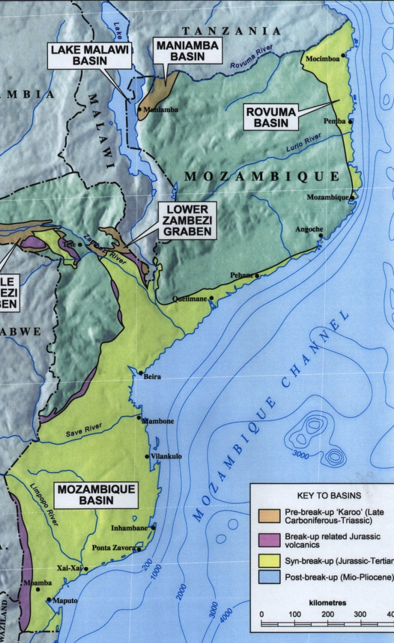
MOZAMBIQUE NATURAL GAS DISCOVERIES AND POTENTIAL USES
1. Recoverable gas reserves discovered: >160 TCF; 2. Future use of the gas: Natural Gas Master Plan to be approved shortly. Preliminary results recommend: - LNG for exports; - Power generation plants; - Fertilizers (urea); - GTL; - Industrial consumption; - Domestic consumption.

