Slide 1
Enabling rural areas in Africa with
GSM and Broadband
Sustainable solutions from VNL
Notes:
1

Slide 2

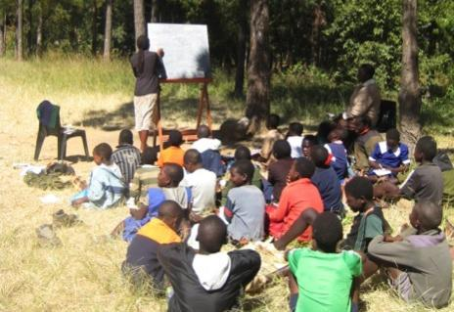
The Great Divide
City
Village
Notes:
2

Slide 3

The future is about leapfrogging traditional models and thinking fresh.

Slide 4

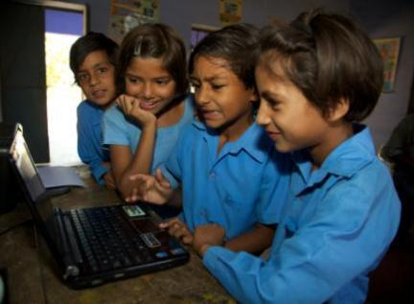
Bridging the Digital Divide
Technology is a great equalizer

Slide 5
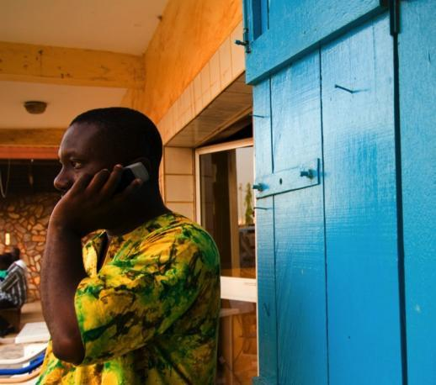
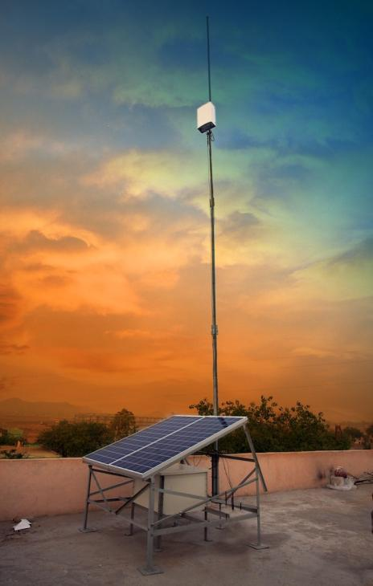



Once there is communication, anything is possible.

Slide 6
Future Needs of Society
Villages have no proper modes of sharing of important announcements/ information
No GSM mobile coverage in villages
Early warning of any Natural or Man-made disasters
No surveillance system in place
Lack of day to day information that can be useful for farmers and Panchayat
Information sharing by Government to beneficiary of Government schemes

Slide 7
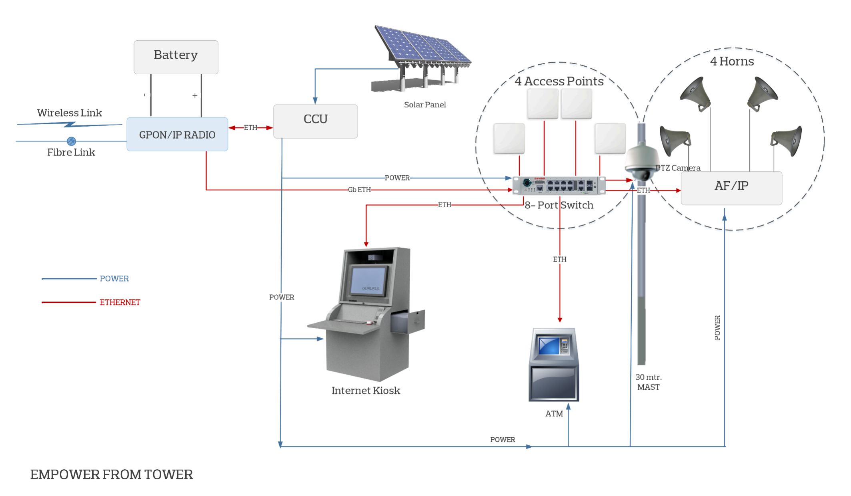

Slide 8
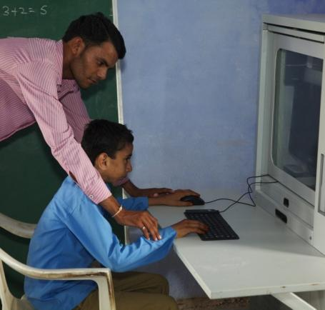
  The integrated solution simultaneously supports both GSM and Broadband and can be deployed in any combination – standalone GSM or high speed broadband, or both.

Slide 9
Benefits
Lowering add on costs for each additional application/ service and expanding reach with VNL Telecom towers
Public Address System enables the effective dispersion of any information or announcements
Keeping communities safe by improving surveillance & emergency services
The internet kiosk provide access to important information over internet and browsing
Solar Power based completely green energy solution
One stop indigenous solution point for all needs

Slide 10

E-Gurukul Features
Smart engineered system is rugged, robust and self-contained
High bandwidth
Tamper-proof housing keeps all the peripherals secure
State-of-the-art security features are built in
Simple to install and connect
Near zero maintenance
No need of Grid Power or Diesel
Totally, solar-powered solution
3 days Autonomy
Notes:
10

Slide 11
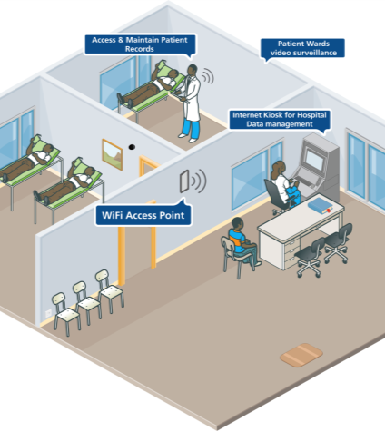
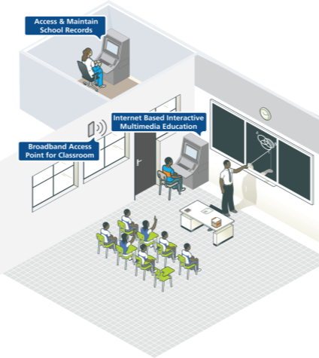
E-Gurukul: Applications
Hospitals
Schools

Slide 12
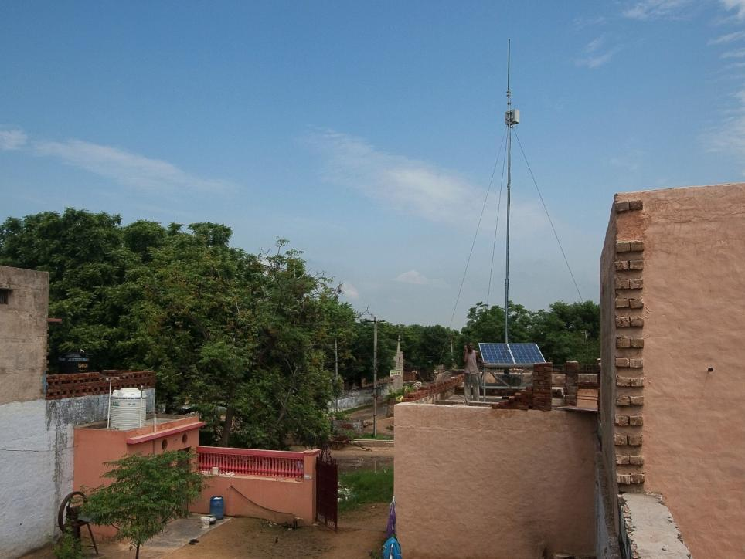
From Rajasthan, India,
VNL has traveled across the world.

Slide 13
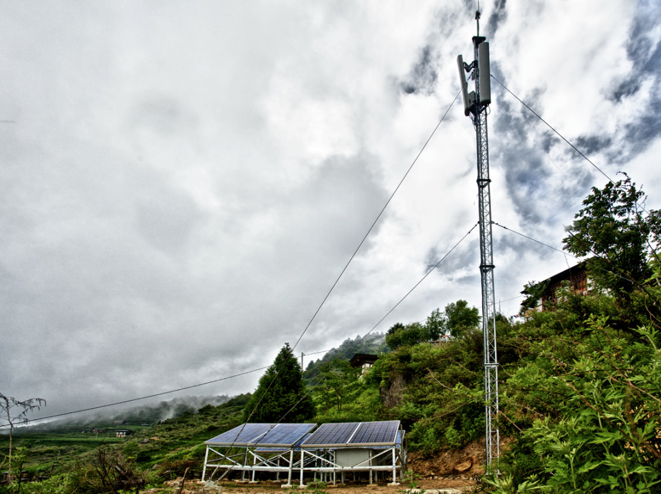
Bhutan

Slide 14
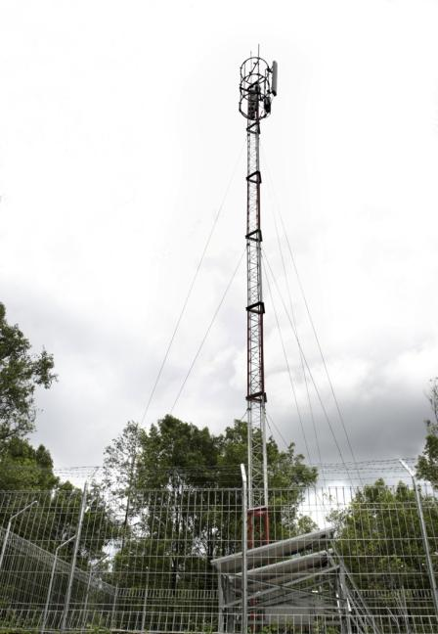
Indonesia
Indonesia

Slide 15
Kenya

Slide 16
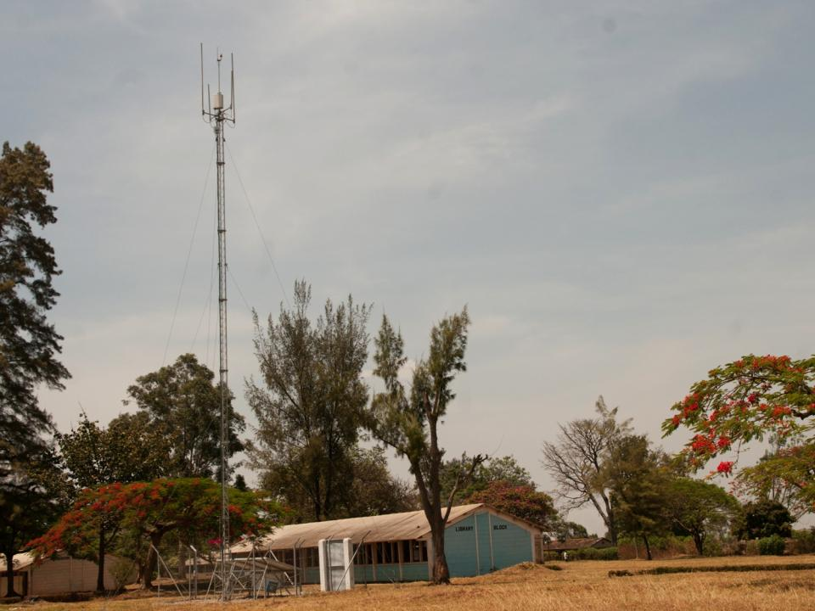
Uganda

Slide 17
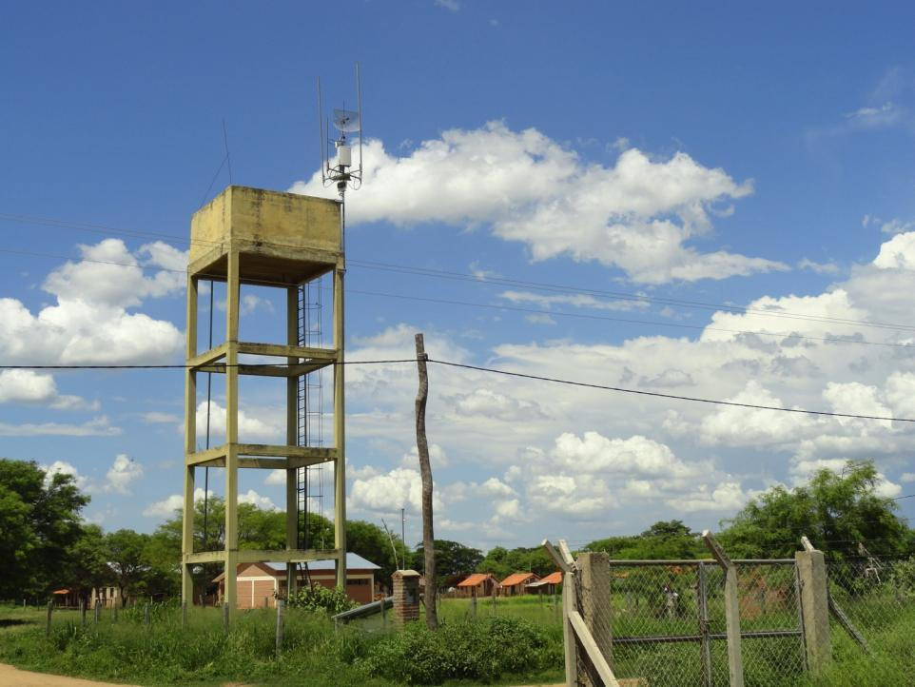
Bolivia

Slide 18
About VNL
What we do
  Design, develop and manufacture telecom infrastructure
  Specialize in low density, completely solar powered networks for low revenue markets.
Company facts
  Founded in 2004; head office in New Delhi
  Part of billion dollar group - Shyam – India’s leading diversified telecommunications group.
Notes:
18

Slide 19
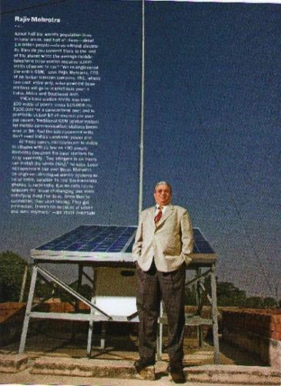
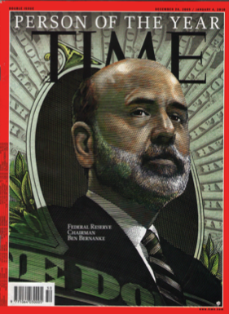
The Man behind VNL
One of 8 people who will change your life – TIME Magazine

Slide 20
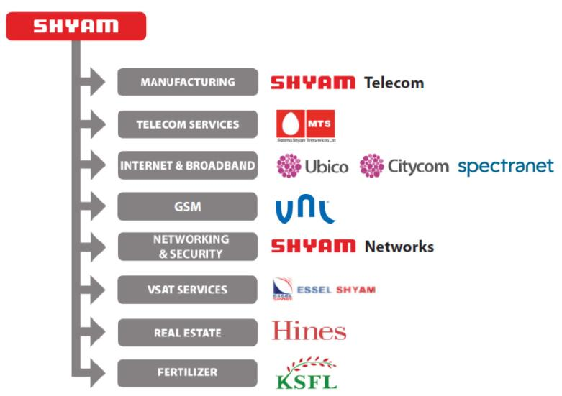
About Shyam Group

Slide 21





The new member of The Club.

Slide 22




Worldwide recognition

Slide 23

Enable the future.

Slide 24
Thank You
www.vnl.in

